Slide 1
OARSI Preconference Workshop on Statistical Analysis
April 30th, 2015

Slide 2
Introduction and Thanks to Our Panel
Jonas Ranstam, Ph.D.
Dr. Ranstam is a medical statistician, chartered by the Royal Statistical Society and Science Council in the UK, professor of medical statistics at Lund University, Sweden, and a statistical adviser to a number of organisations and scientific journals, including Osteoarthritis & Cartilage.
Follow his blog: statisticalmistakes.com
Or on Twitter: @jonasranstam

Slide 3
Introduction and Thanks to Our Panel
Ruby Chang, Ph.D.
Dr. Chang is a Lecturer in Statistics at the Royal Veterinary College and a chartered Statistician of the Royal Statistical Society. Dr. Chang provides statistical support on study design and data analysis for students, staff and faculty and has collaborated in the areas of statistical modeling and algorithm development.

Slide 4
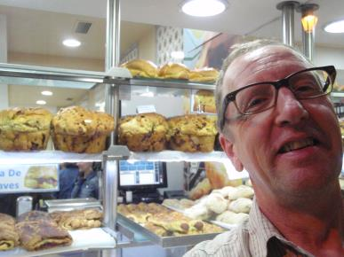
Introduction and Thanks to Our Panel
Robert Buck, Ph.D.
Dr. Buck is a statistical consultant with StatAnswers Consulting LLC. Prior to founding StatAnswers Consulting LLC, Dr. Buck was a Biostatistician at Pfizer, working in imaging biomarker validation and normalization techniques for microarray analysis.

Slide 5
Opening Questions for the Panel
What is the most common error that you see in statistical analysis of biological data sets?

Slide 6
Opening Questions for the Panel
What’s the more common pitfalls in statistical analysis, in your experience?
Sticking strictly to the original statistical design when there was still ‘meat on the bone’
Or
Overanalyzing the data and tweaking the statistics to the point where the analysis is meaningless

Slide 7
Opening Questions for the Panel
What’s the more common pitfalls in statistical analysis, in your experience?
Underpowered experimental designs that stretch the statistical theory beyond its original intent.
Or
Failure to identify statistical difference because the wrong statistical tests were employed.

Slide 8
Format for the Workshop
Today, we’ll present a number of case-studies and let our panel offer suggestions on how to handle these common issues in statistical analysis and presentation.
Note for the audience:
The examples included in this presentation are 100% fictional and were generated for the purposes of this workshop.
The slides for the workshop are available at
www.oarsi.org\.......
http://bme.ufl.edu/labs/allen/resources.html

Slide 9
Statistical Independence

Slide 10
Colin’s Experiment
Colin collects the following sample for his PCR experiment
8 Samples from Wildtype Mice
8 Samples from Heterozygote Mice
8 Samples from Homozygote Knockout Mice
He runs the PCR assay, measuring each sample 3 times.
When analyzing the differences between wildtype, heterozygote, and homozygote mice, is this n=24 per group or n=8 per group?
Or, are none of the samples independent because the assay was only run one-time?
Heterozygote
8 Mice
Wildtype
8 Mice
Homozygote
8 Mice
Sample 1 | Wildtype | Measurement 1
Sample 1 | Wildtype | Measurement 2
Sample 1 | Wildtype | Measurement 3
Sample 2 | Heterozygote | Measurement 1
Sample 2 | Heterozygote | Measurement 2
Sample 2 | Heterozygote | Measurement 3
Sample 3 | Homozygote | Measurement 1
Sample 3 | Homozygote | Measurement 2
Sample 3 | Homozygote | Measurement 3
Sample 4 | Wildtype | Measurement 1
Sample 4 | Wildtype | Measurement 2
Sample 4 | Wildtype | Measurement 3
Sample 5 | Heterozygote | Measurement 1
Sample 5 | Heterozygote | Measurement 2
Sample 5 | Heterozygote | Measurement 3
Sample 6 | Homozygote | Measurement 1
Sample 6 | Homozygote | Measurement 2
Sample 6 | Homozygote | Measurement 3

Slide 11
Ahmed’s Experiment
Ahmed is planning to run an ELISA shown above. The top two rows will be used to form a standard curve, but in rows 3-8, Ahmed places a different treatment group. Each sample is placed into the well plate 3 times (triplicate).
What is n – 4 or 12? Is this repeated measures? Or is measuring the sample in the triplicate primarily used to assess the accuracy of the experimental method?

Slide 12
Ahmed’s Experiment
Animals (6 knees from 6 animals)
- A, B, C, D, E, F, G
Growth Factors (5 different types of growth
factors)
- No Treatment Control, BMP2, TGF-B1, TGF-B3, IGF1
Measured in Triplicate
Ahmed repeats the experiment, but with a new twist. He obtains chondrocytes from 6 different cow knees, but he doesn’t mix the samples, instead each population of cells is from a distinct knee. He exposes each population to 4 different growth factors and keeps one group as a control.
Is this better handled as a 2-way ANOVA or as a 1-way, repeated measures ANOVA?
How can we decide when it’s repeated measures, when the variable should be treated as a factor, or when it’s an estimate of experimental error?
What if Ahmed uses different plates? Is plate a factor?

Slide 13
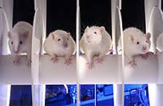
Summer’s Experiment
Summer is conducting a behavioral experiment on the same animals used by Colin. Summer is testing an animal’s ability to stay on a rotating rod (Rotarod). It is well known that with an increasing number of trials, an animal will preform better on the behavior test (see graph to right). She repeats the experiment 5 times.
How should she manage these data and maintain statistical independence between samples?

Slide 14
P-value Hacking and Multiplicity

Slide 15
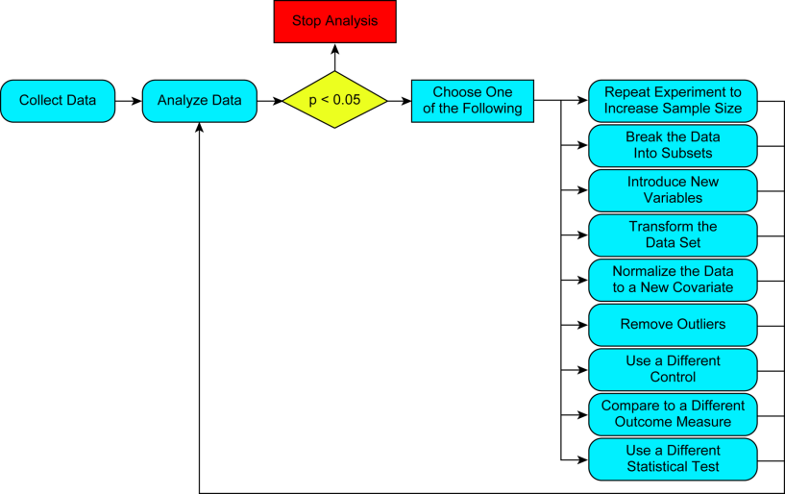
What is P-value Hacking?
Yes
No
Where is the line between p-hacking
and data analysis?
What if the experiment didn’t behave as anticipated? Can the analysis not be adapted?
Simmons JP, Nelson LD, and Simonsohn U (2011), “False-positive physchology: undisclosed flexibility in data collection and analysis allows presenting anything as significant”. Physchol Sci, 22: 1359-66.

Slide 16
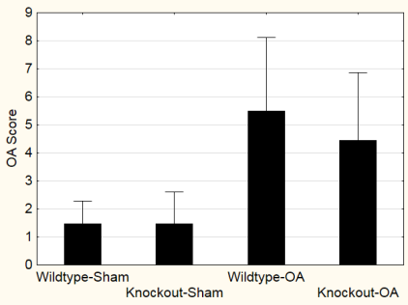
Joshua’s Experiment
Joshua is investigating whether a particular knockout mouse is protected from OA or not. He starts off by analyzing 5 mice per group and gets the results shown to the right. He runs a statistical test, but does not see protection in his knockouts
His advisor says, “Well, it was just a pilot experiment. Let’s do it again with 10 mice per group this time.”

Slide 17
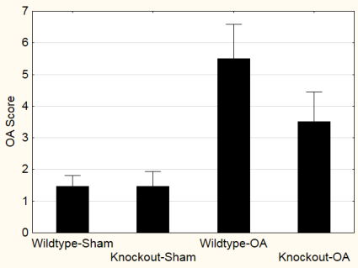
Joshua’s Experiment
Joshua does as his advisor suggests. His 2nd experiment shows a similar result, but still no significance. However, if he combines his 1st and 2nd experiment (n=15), he gets statistical significance. He does this and writes it up.
Is Joshua p-value hacking?
How could these results be fairly reported in a manuscript?

Slide 18
P-values vs. Effect Sizes
Are p-values sufficient on their own?
Should p-values be used at all?
How can we emphasize effect size in our publications?

Slide 19
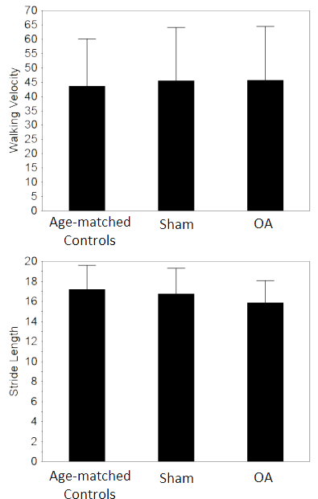
Juliana’s Experiment
Juliana conducts an experiment where she assesses the stride length and walking velocity of rats with a sham surgery, rats with an ACL transection, and age-matched controls. To begin the experiment, she examines velocity and stride length using 1-way ANOVAs, shown to the right. She gets no significance.
She thinks ‘The OA group looks like it’s taking shorter strides… why won’t this work.’

Slide 20
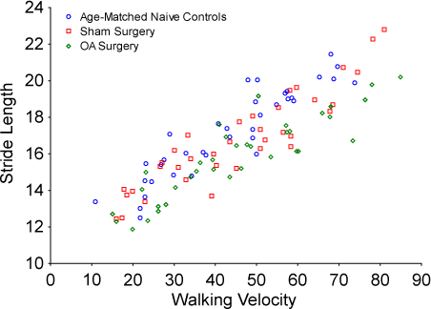
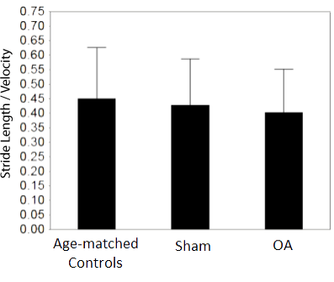
Juliana’s Experiment
Walking into work, Juliana thinks, “Hey, if I walk faster, I take longer strides. I wonder what my data will look like if I look at stride length and velocity simultaneously.” She plots her data, and…. convinces herself that the OA data is lower, but it’s just not clear enough. So, she creates a new variable, which she calls stride length over velocity… still no significance.

Slide 21
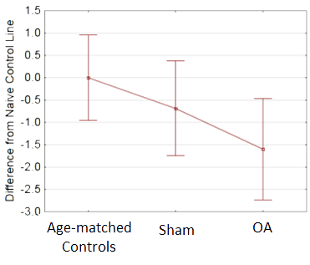
Juliana’s Experiment
Juliana presents her data to her group, and a post-doc in the laboratory suggests that she fit a regressopm line to her naïve data and use that as a ‘normalization line’ for her experiment. Juliana does this and re-investigates her data set. She finds….. Success!!! Statistical Significance!!!
**
**
**

Slide 22
Juliana’s Experiment
Can she ‘residualize’ the data to analyze stride length at a given velocity?
Are trials at a different velocity truly independent? Or, should she take the average residual for a given animal?

Slide 23
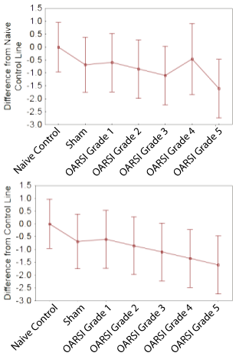
Juliana’s Experiment
Juliana actually has data for different levels of OA severity, so she re-does her analysis for each level of OA severity. The data are shown to the left as mean +/- st. dev. She notices the Grade 4 data doesn’t follow the trend that she was expecting. She examines this data and sees a value that appears to be an outlier. She drops this point and re-does her analysis. Perfect!

Slide 24
Juliana’s Experiment
Juliana does the Bonferroni post-hoc test first – standard practice for her lab. Hmm… Only the Grade 4 and Grade 5 groups show difference from Baseline, and no differences from Sham. So, Juliana tries Tukey’s HSD test, and now Grade 5 shows difference from Sham. Hmm… Juliana tries Newman-Keuls test, and now both Grade 4 & 5 are different from sham, AND Grade 3 is different from naïve control. She thinks, “Let’s go with the Newman-Keuls test.”

Slide 25
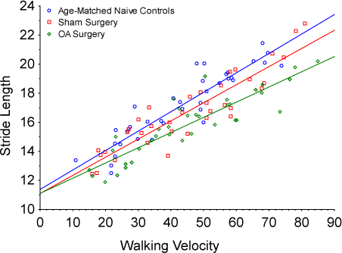
Juliana’s Experiment
Juliana’s paper comes back and one of the reviewers recommends that Juliana analyze the data using different regression model that accounts for the effects of the velocity covariate. Juliana does this, and it looks like at higher speeds, the difference in stride lengths. How can she report this effect?

Slide 26
The Eyeball Test vs. The Statistical Test

Slide 27
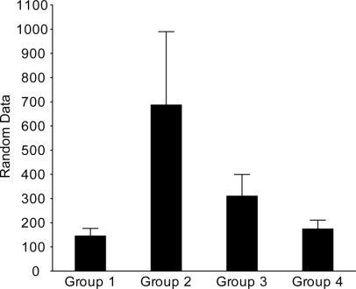
Jimmy’s Experiment
Jimmy plots his data as mean ± standard error, a common practice in his lab. He thinks, “My data looks like it should be significant, but I can’t get statistical significance in my 1-way ANOVA”. He runs a Fisher’s LSD anyway and gets significance between Groups 1&2 and between Groups 2&4; then, decides to go forward with publishing his results.
P = 0.096, n = 6
Mean +/- SEM
Why is Fisher’s LSD showing significance when the ANOVA is not?
If the ANOVA was significant, would Fisher LSD be appropriate here?

Slide 28
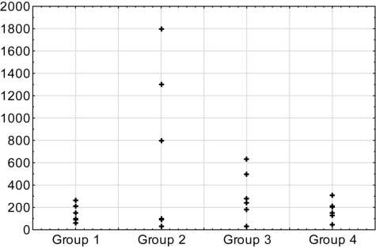
Jimmy’s Experiment
Remember, Jimmy plotted his data as mean ± standard error. If he had plotted his raw data, he would have got the graph below. Is Jimmy violating the assumptions of an ANOVA?
ANOVA Assumptions
Independent random samples
Distribution of the response is normal
Population variance are equal across groups
Scatterplot
Random Data

Slide 29
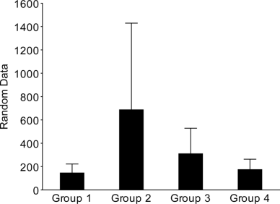
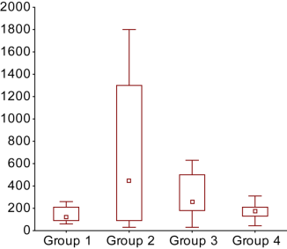
Is the plot of the data misleading?
Mean +/- SEM
Scatterplot
Random Data
Boxplot
Mean +/- St. Dev.
Random Data

Slide 30
Question for the panel
As a statistician/scientist, how should data be presented? In its rawest possible form? As a direct representation of the statistical method used?

Slide 31
Violating the Assumptions of an ANOVA

Slide 32
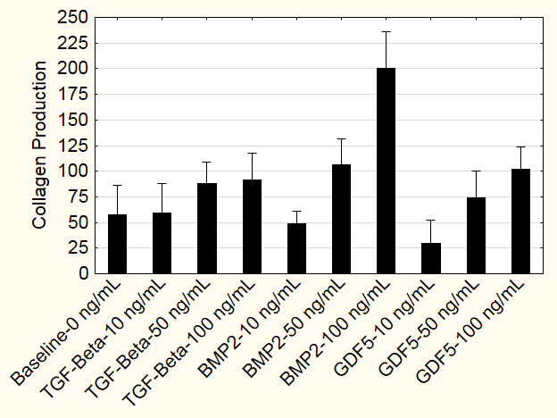
Claudette’s Experiment
Claudette conducts a tissue engineering experiment, where she measures collagen production after exposure to a growth factor. She intends to run a 2-way ANOVA, with growth factor type and concentration as the factors. But when she runs her ANOVA, she gets an error message stating that the design of her experiment is not balanced.
Can she run multi-factor ANOVA and still incorporate the baseline data?

Slide 33
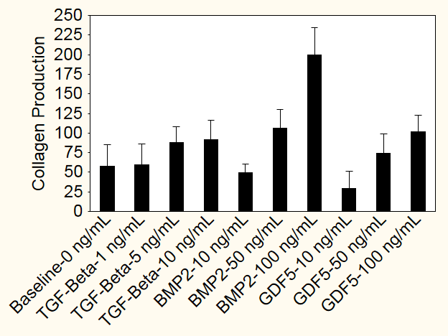
Claudette’s Experiment
Because the ANOVA won’t run, Claudette decides to copy the baseline data and paste it into the following categories:
- TGF-beta – 0 ng/mL
- BMP2 – 0 ng/mL
- GDF5 – 0 ng/mL
This balances here ANOVA, but now data that originally represented 5 samples has be copy-pasted to represent 15 samples. Is Claudette violating statistical independence assumptions? Is this a valid way to balance the ANOVA?

Slide 34
Claudette’s Experiment
Convinced she’s violating statistical independence assumptions by copy-pasting data, Claudette decides to just eliminate the baseline data from her data set and run a 2-way ANOVA without the baseline data included. She then runs a post-hoc Fisher’s LSD test to compare differences between groups, and a separate Dunnett’s test to compare each group to baseline.
Is this approach ok?

Slide 35
Ordinal Data

Slide 36
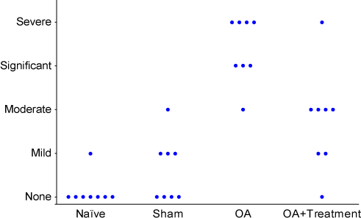
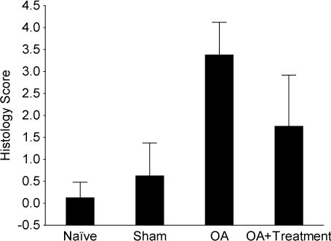
Maggie’s Experiment
Mean +/- St Dev.
Maggie runs an experiment where she evaluates the efficacy of a novel anti-inflammatory agent. At the conclusion of the experiment, she conducts an immunofluorescent stain to investigate the presence of macrophages in the synovium. At her laboratory meeting, she presents the images to her colleagues and asks the group to come to consensus on the severity of macrophage infiltration in each image (the group is blinded). The data are shown to the right. Maggie is asked to run stats on the data, so she converts “severe” to a value of 4, “significant” to a value of 3, and so on; then runs an ANOVA on the data. Are there other methods Maggie should consider here?

Slide 37
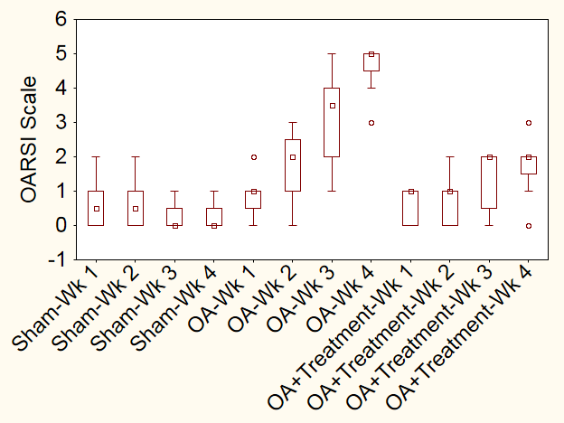
Hans’s Experiment
Hans conducts an experiment on a potential OA treatment, investigating the severity of joint damage at 1, 2, 3, and 4 weeks after disease initiation using the OARSI Histopathology Scale (2006 version). Hans begins to run the Kruskal-Wallis test, but thinks “I have 2 factors here – group and time. Is there a 2-factor non-parametric ANOVA? Should I just use the parametric ANOVA to account for my two factors?”

Slide 38
What to do about “Outliers”? And, when are outliers really outliers?

Slide 39
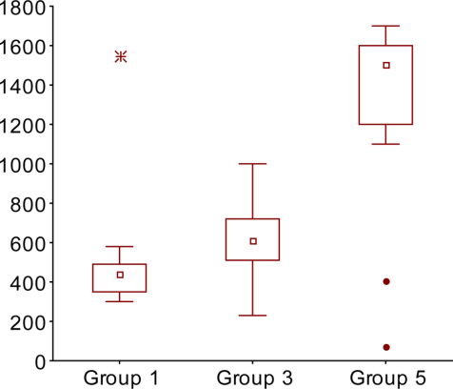
Charlotte’s Experiment
Charlotte collects the data shown to the right. In Group 1 and Group 5, she has several data points that seem to be outliers. Without knowing anything else about the experiment, should these points be eliminated from the analysis?

Slide 40
Charlotte’s Experiment
Upon examining her laboratory notebook, Charlotte notes that a machine malfunction occurred for the highlighted data point.
Should this point be eliminated from the analysis? How should Charlotte report this in her paper?

Slide 41
Charlotte’s Experiment
Upon further examination, Charlotte discovers that the fire alarm went off when the highlighted data were collected. This caused the samples to incubate longer than the others. She removes these data along with the data lost due to the machine malfunction, but now she has unequal n’s between her groups.
Should she do something to account for the missing data?
When should unequal n’s between groups be considered as a statistical problem?

Slide 42
P-values vs. Effect Sizes

Slide 43
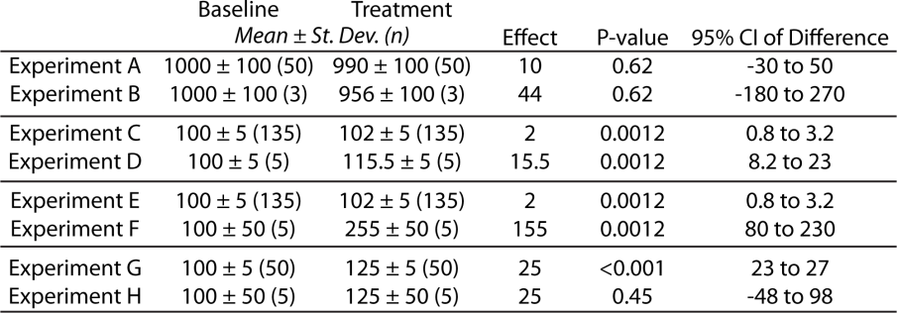
Claire’s Experiment
Part 1: Claire conducts the following study
- In Experiment A, Claire measures the urine concentration of an OA biomarker in a sham surgery control (Baseline, n=50) and in a mouse OA model (Treatment, n=50).
- In Experiment B, Claire measures a biomarker signal using an experimental imaging technique; however, due to time and expense, only 3 samples were acquired in each group.
As Claire’s statistical consultant, which experiment do you suggest Claire focus on and why?

Slide 44
Claire’s Experiment
Part 2: Claire does the same technique in humans
- In Experiment C, Claire measures the urine concentration of an OA biomarker in a non-OA population (Baseline, n=135) and in OA patients (Treatment, n=135).
- In Experiment D, Claire measures a biomarker signal in an experimental imaging technique; however, due to time an expense, only 5 samples were acquired in each group.
As Claire’s statistical consultant, which experiment do you suggest Claire focus on and why?

Slide 45
Claire’s Experiment
Part 3: Claire wants to compare her data with another OA biomarker. A colleague has some excess samples for this study.
- In Experiment E, Claire’s colleague measures the urine concentration of a standard OA biomarker in a non-OA population (Baseline, n=135) and in OA patients (Treatment, n=135).
- In Experiment F, Claire measures her novel biomarker signal in 5 samples.
- Both experiments have the same p-value.
As Claire’s statistical consultant, do you expect Claire’s novel biomarker to have greater sensitivity?

Slide 46
Claire’s Experiment
Part 4: Claire is writing a review paper covering Experiment G & H. Claire concludes that the biomarker in experiment G must be more sensitive to OA changes because the p-value reported in Experiment G was significant.
As Claire’s statistical consultant, do you agree with Claire’s conclusion?

Slide 47
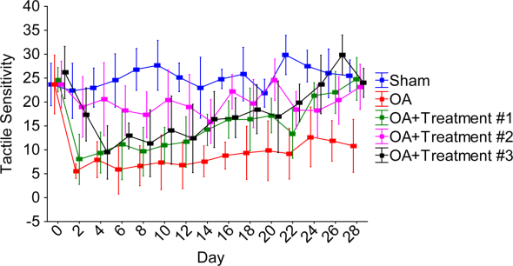
Lin’s Experiment
Lin is investigating the efficacy of 3 different pain therapeutics for osteoarthritis. His experiment includes a sham and untreated controls.
How would you recommend analyzing this experiment? How would you handle the Day 0 control in the experiment?

Slide 48
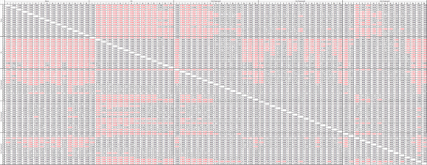
Lin’s Experiment
Lin decides to run a 2-way ANOVA with a post-hoc Tukey’s HSD test. His results are shown in the top heat map. Lin thinks the heat maps are just too confusing… Lin only cares whether the different treatments improve OA symptoms at different time points. So, Lin decides to analyze the differences between groups at each time point with 14 different 1-way ANOVAs. Is this allowed? Are there better methods?

Slide 49
Lin’s Experiment
Lin’s paper comes back from review, and the reviewer says, “Why do 14 different 1-way ANOVAs? There are 10 different comparisons at each time point, and 15 different time points. Just make a Bonferroni correction for 150 planned comparisons after your full model.” Lin does the math – 150 corrections – that means the new p-value should be 0.05/150 = 0.00033. Wow! That’s low. Is that too harsh? Should Lin be running planned comparisons here?

Slide 50
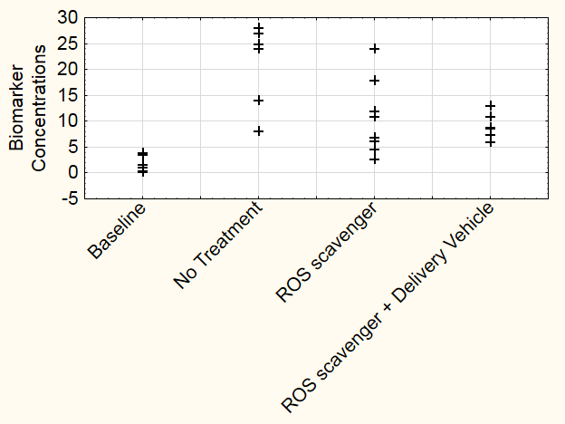
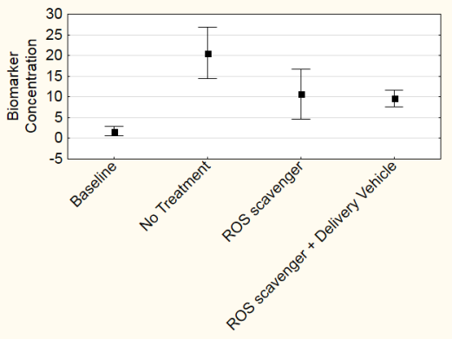
Yuki’s Experiment
Yuki measures biomarker concentrations in the following experimental groups:
- No OA control
- OA without Treatment
- OA plus treatment with a ROS scavenger
- OA plus treatment with a ROS scavenger released from a delivery vehicle
His data are shown to the right in two different graphs.
Raw Data
Mean +/- 95% CI

Slide 51
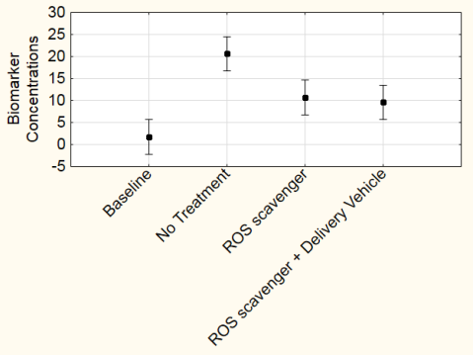
Yuki’s Experiment
Raw Data
Yuki runs a 1-way ANOVA and it provides the bottom graph.
Why is the bottom graph different from the middle graph?
How should these data be presented?
How should these data be analyzed?
Do the graphs and statistics need to align?
Mean +/- 95% CI
Mean +/- 95% CI
(from ANOVA)

Slide 52
Yuki’s Experiment
Yuki tests differences between his groups using a series of t-tests, where he assumes equal variance between groups. His results are shown in the table below.
 |  |  |  | Baseline | No Treatment | ROS scavenger | ROS scavenger + Delivery Vehicle
 | N | Mean ± St. Dev. | 95% Confidence Interval | 95% Confidence Interval on Difference
Baseline | 8 | 1.73 ± 1.39 | 0.92 to 2.83 |  | -24.66 to -13.15 (p < 0.0001) | -14.54 to -3.34 (p = 0.0041) | -10.06 to -5.72 (p<0.0001)
No Treatment | 8 | 20.64 ± 7.46 | 4.93 to 15.18 | 13.15 to 24.66 (p < 0.0001) |  | 2.08 to 17.85 (p =0.0169) | 5.05 to 16.98 (p =0.0014)
ROS scavenger | 8 | 10.68 ± 7.25 | 4.79 to 14.75 | 3.34 to 14.54 (p = 0.0041) | -2.08 to -17.85 (p =0.0169) |  | -4.76 to 6.86 (p =0.7043)
ROS scavenger + Delivery Vehicle | 8 | 9.63 ± 2.50 | 1.65 to 5.09 | 5.72 to 10.06 (p<0.0001) | -5.05 to -16.98 (p =0.0014) | -6.86 to 4.76 (p =0.7043)
 |  |  |  | Baseline | No Treatment | ROS scavenger | ROS scavenger + Delivery Vehicle
 | N | Mean ± St. Dev. | 95% Confidence Interval | 95% Confidence Interval on Difference
Baseline | 8 | 1.73 ± 1.39 | 0.92 to 2.83 |  | -24.66 to -13.15 (p = 0.0002) | -14.54 to -3.34 (p = 0.0099) | -10.06 to -5.72 (p < 0.0001)
No Treatment | 8 | 20.64 ± 7.46 | 4.93 to 15.18 | 13.15 to 24.66 (p = 0.0002) |  | 2.08 to 17.85 (p =0.0170) | 5.05 to 16.98 (p = 0.0037)
ROS scavenger | 8 | 10.68 ± 7.25 | 4.79 to 14.75 | 3.34 to 14.54 (p = 0.0099) | -2.08 to -17.85 (p =0.0170) |  | -4.76 to 6.86 (p = 0.7078)
ROS scavenger + Delivery Vehicle | 8 | 9.63 ± 2.50 | 1.65 to 5.09 | 5.72 to 10.06 (p < 0.0001) | -5.05 to -16.98 (p =0.0037) | -6.86 to 4.76 (p =0.7078)

Slide 53
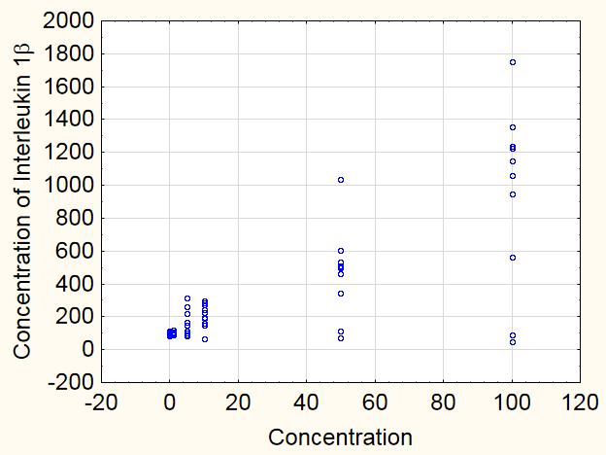
Carlos’s Experiment
Carlos exposes chondrocytes to varying concentrations of an potential OA initiator, then measures the production of interleukin-1 in the media. To analyze this experiment, Carlos runs a 1-way ANOVA, but…
Should Carlos be concerned about the increasing amount of variation in his groups? If so, how might Carlos handle this issue in his analysis?

Slide 54
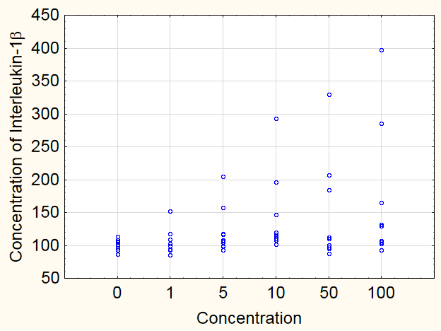
Carlos’s Experiment
Carlos conducts another experiment, where he exposes chondrocytes to varying concentrations of a different potential OA initiator, then measures the production of interleukin-1 in the media. To analyze this experiment, Carlos runs a 1-way ANOVA, but…
Should Carlos be concerned about the increasing amount of variation in his groups? What about the lack of normality in his data? How might Carlos handle these issues in his analysis?

Slide 55
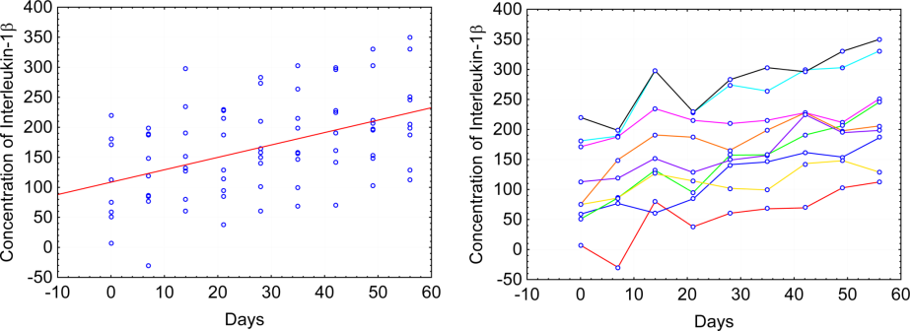
Carlos’s Experiment
Carlos conducts another experiment, where he exposes chondrocytes to a potential initiator of OA then measures concentrations over time. The different color lines represent chondrocyte cultures from different animals. To analyze this experiment, Carlos runs a 1-way ANOVA, but…
Should Carlos consider inter-animal variation? And what options does he have available to consider inter-animals variability?

